Slide 1
SEMINAR ON DKA MANAGEMENT
PREPARED BY:
Name
1.Abenazer Isayas
2.Abdisa Gebre
3.Aschalew Yenenew
4.Biniyam Dejene
MODERATOR: Dr. Bereket
(MD, Ass’t professor of pediatrics and child health)
Date:
Asella, Oromia, Ethiopia

Slide 2
Outline
Introduction
Pathophysiology Of DKA
Clinical feature Of DKA
Diagnosis of DKA
Investigation of DKA
Differential Diagnosis
General management and approach Of DKA
Fluid and electrolyte management
Insulin therapy
Monitoring
Complication during management and prevention

Slide 3
INTRODUCTION
Diabetes Mellitus (DM)
Diabetes Mellitus is not a single disease entity.
It is a group of common chronic metabolic disorders sharing a common underlying feature of hyperglycemia.
It is progressive disease effecting numerous aspects of metabolism, beyond those related to glucose homeostasis
Hyperglycemia in DM results from defects in insulin secretion, insulin action, or, both

Slide 4
Etiologic Classifications of DM
Reflects the major etiologies and pathogenic pathways that are thought to lead to diabetes
The ADA has proposed a diabetes classification system in 4 categories:
  type 1 diabetes,
  type 2 diabetes,
  other specific types, and
  Gestational DM

Slide 5
Type 2 Diabetes Mellitus
Due to insulin resistance with relative insulin deficiency
Associated with:
  Obesity
  Family history
  Sedentary lifestyle
The incidence of T2DM among youth is increasing in many countries

Slide 6
Other Specific Types
Genetic Defects Of β-Cell Function and Insulin Action
Other Genetic and Autoimmune Syndromes Associated With Diabetes
Drug Or Chemical Induced and Infections
Diseases of E.Pancreas and Associated Endocrinopathies

Slide 7
Type 1 Diabetes Mellitus
Most common form in children
Caused by autoimmune destruction of pancreatic β-cells
Results in absolute insulin deficiency

Slide 8
Epidemiology
T1DM is the most common in childhood and adolescence.
It accounts for approximately 10% of all cases of diabetes in all ages.
F=M
Peaks of presentation occur in two age- groups: at 5- 7 (the time of increased expo sure to infectious agentes) and, at puberty, due to increasing in gonadal steroids and GH secretion (which antagonizes Insulin),

Slide 9
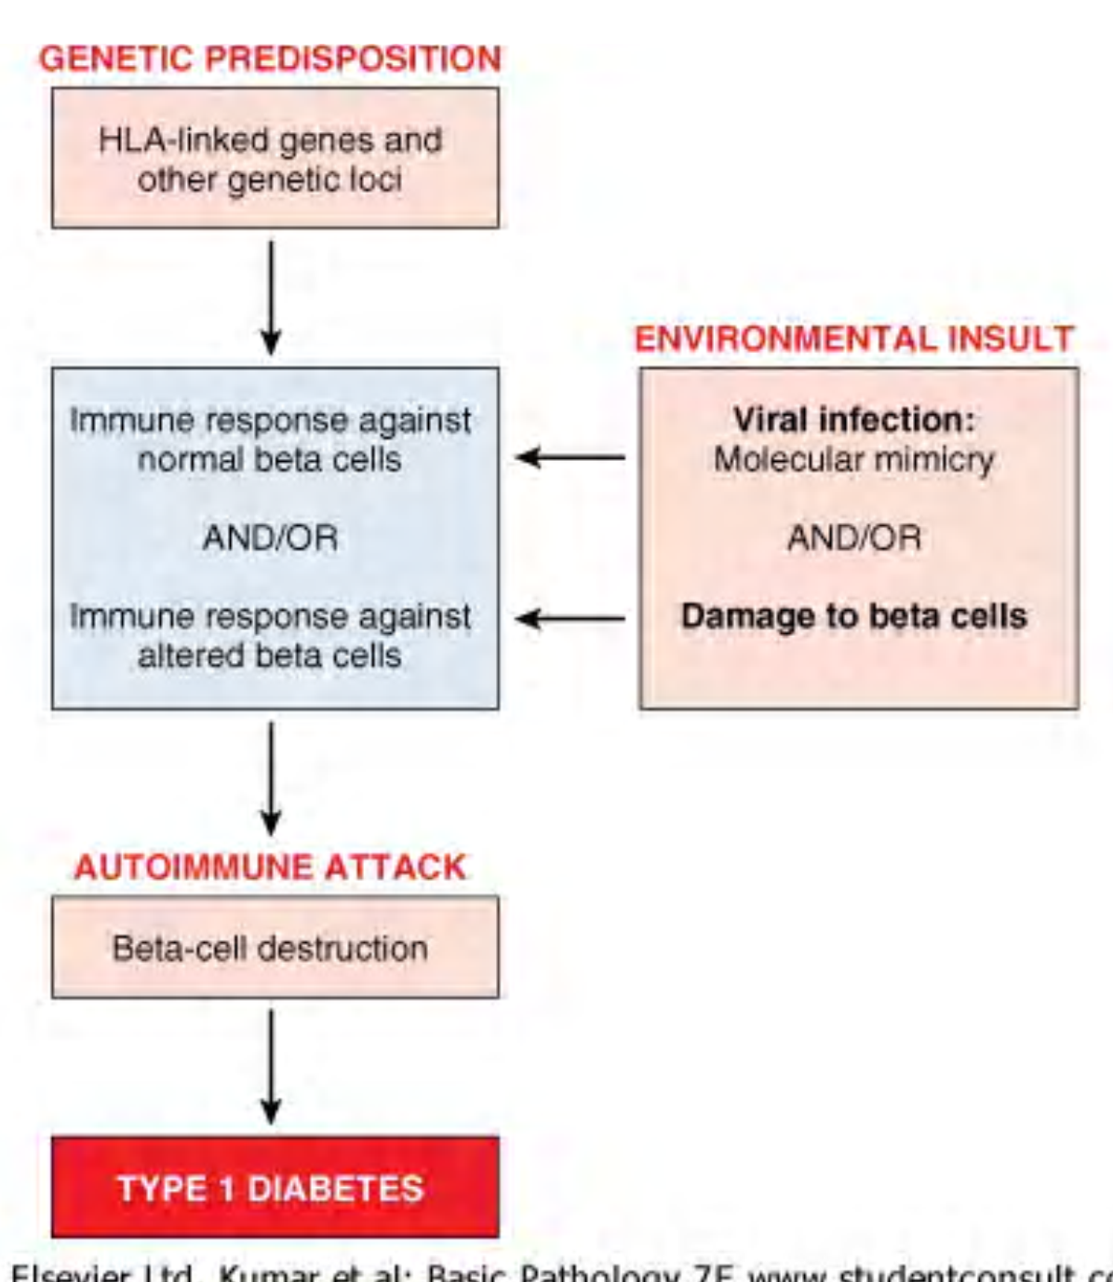
Pathogenesis of T1DM

Slide 10
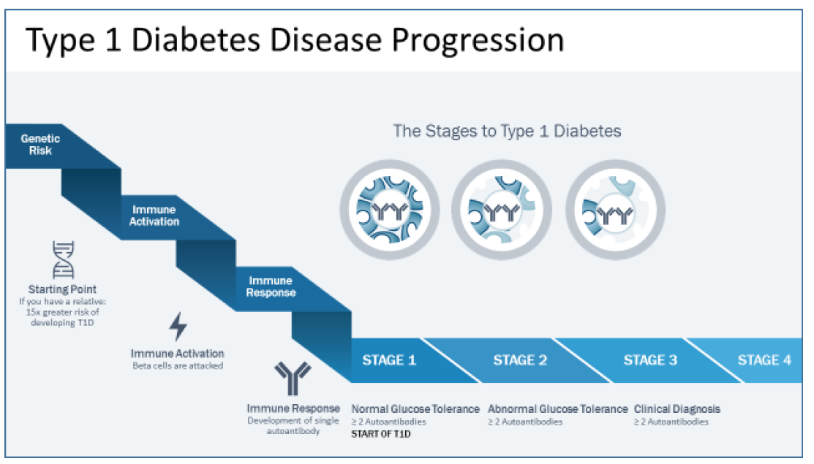
Natural History of Type 1 Diabetes Mellitus

Slide 11
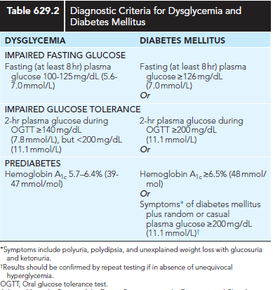
Criteria for the Diagnosis of Diabetes Mellitus

Slide 12
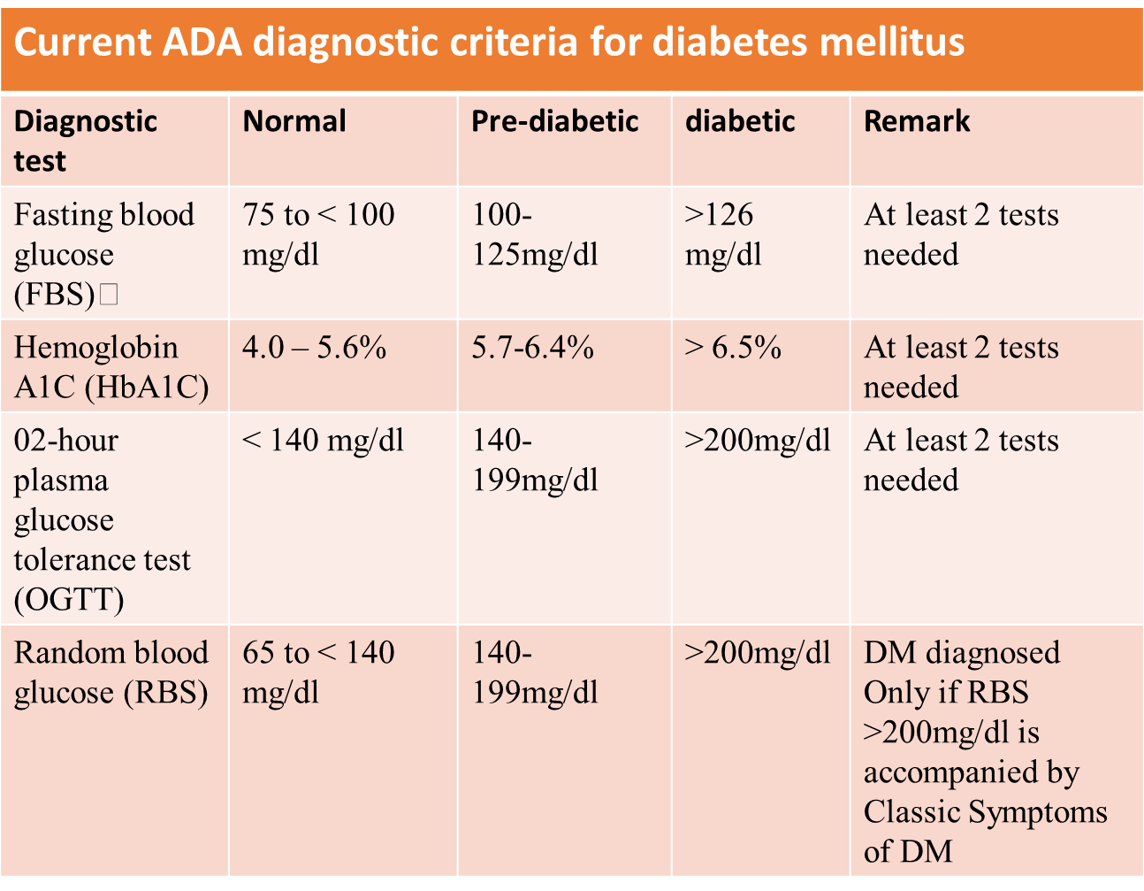

Slide 13
Complications of DM
Chronic complications:
Acute complications:
Diabetic Ketoacidosis
Hypoglycemia
HHS
Microvascular
Macrovascular

Slide 14
Diabetic Ketoacidosis (DKA)
Diabetic ketoacidosis (DKA) is an acute, life-threatening complication of diabetes mellitus.
Formerly considered a hallmark of type 1 DM.
also occurs in individuals with type 2 DM
      Ketosis-prone diabetes mellitus
Characterized by:-
            hyperglycemia
            ketonemia
            metabolic acidosis

Slide 15
Epidemiology
  DKA is the most common acute complication of T1DM in children.
  20–30% of newly diagnosed type 1 diabetes cases in children present with DKA.
  Major cause of death: cerebral edema (accounts for 60–90% of pediatric DKA deaths).
  Higher mortality in low-resource settings due to delayed diagnosis, limited ICU access, and infections.

Slide 16
RISK FACTORS
Newly diagnosed patients include
Factors that increase DKA at the initial presentation of T1DM include :
Young age (<5 years of age and especially <2 years)
Delayed diagnosis of diabetes
Low socioeconomic status, lack of health insurance
Children living in countries with low prevalence of T1DM

Slide 17
Cont…
Known diabetic patient includes
  Omission of insulin for various reasons
  Children with poor metabolic control or previous episodes of DKA
  Gastroenteritis with persistent vomiting and inability to maintain hydration
  Children with psychiatric disorders, including those with eating disorders
  Difficult or unstable family circumstances (eg, parental abuse)
  Children with limited access to medical services

Slide 18
Pathophysiology of DKA
results from relative or absolute insulin deficiency combined with counterregulatory hormone excess.
Both insulin deficiency and glucagon excess, in particular, are necessary for DKA to develop.

Slide 19
Cont…
The decreased ratio of insulin to glucagon promotes;
  gluconeogenesis,
  glycogenolysis, and
  ketone body formation in the liver, as well as
  substrate delivery from fat and muscle (free fatty acids, amino acids) to the liver.

Slide 20
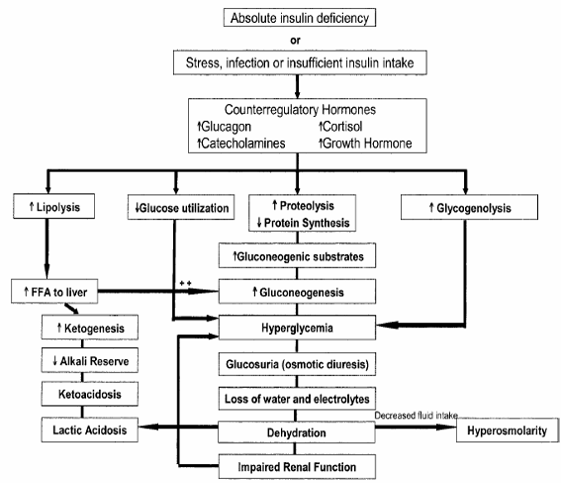

Slide 21
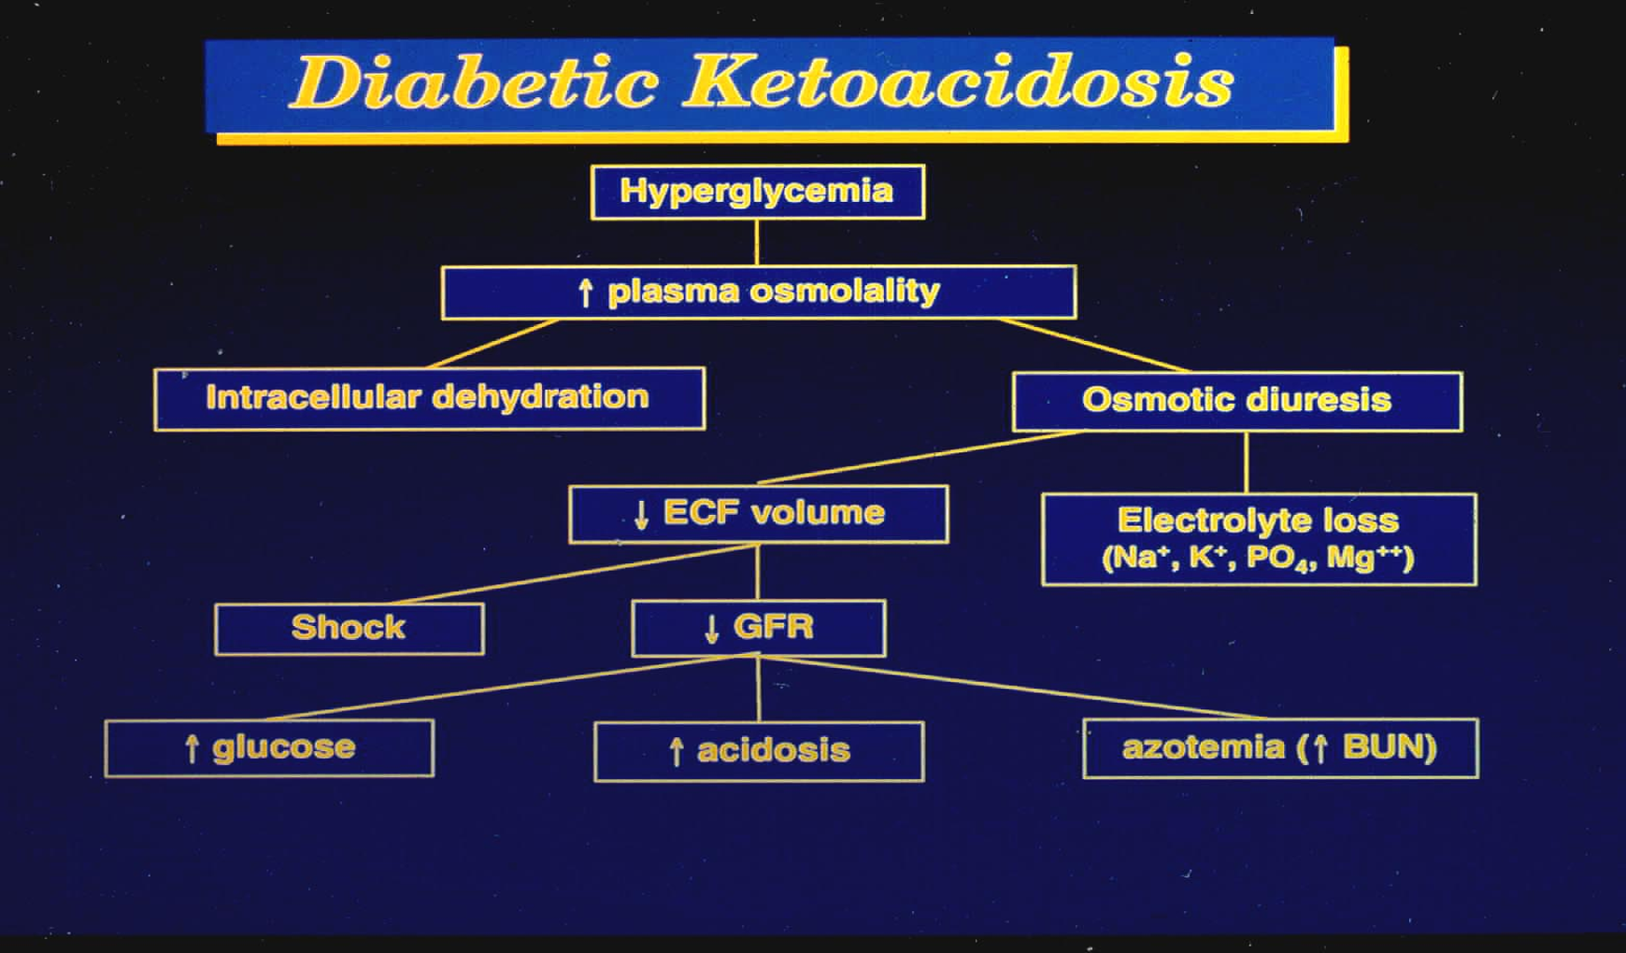

Slide 22
Euglycemic DKA
Euglycemic ketoacidosis occurs with glucose level
< 200mg/dl. Situations in which euDKA occurs include:-
Patients presenting shortly after receiving insulin
Type1diabetics who are young and vomiting
Patients with impaired gluconeogenesis (alcohol abuse or liver failure)
Low caloric intake/starvation
Pregnancy

Slide 23
Approch to DKA
Approch to the patients starts by
  History taking and physical physical examination guide us to diagnosis DKA and HHS.
  Confirm it with lab findings.

Slide 24
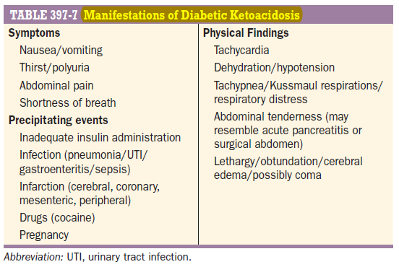
Clinical Features of DKA
Signs and symptoms of DKA are the result of acidosis, hyperglycemia, volume depletion, and electrolyte losses.

Slide 25
Cont..
Infants tend to present with
decreased energy and activity,
Vomiting
Irritability or Lethargy
weight loss, and physical signs of dehydration; a severe Candida diaper rash is common.

Slide 26
The biochemical criteria for the diagnosis of DKA
The diagnosis of DKA is based on the triad of hyperglycemia, ketosis and metabolic acidosis
All three biochemical criteria are required to diagnose DKA
Hyperglycemia (blood glucose >11 mmol/L [200 mg/dL])
Venous pH <7.3 or serum bicarbonate <18 mmol/L
Ketonemia (BOHB ≥3 mmol/L) or moderate or large ketonuria.

Slide 27
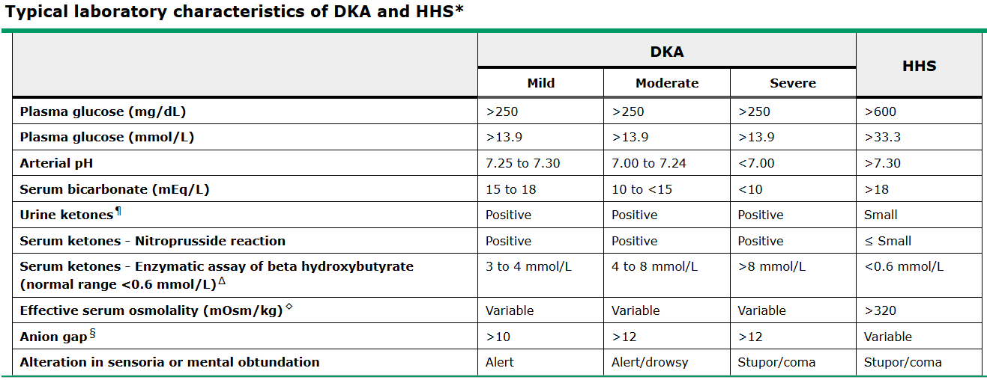

Slide 28
Cont..
Differences in treatment strategy between HHS and DKA include
volume of fluid administered
the timing of administration of insulin
and monitoring of the corrected sodium decline

Slide 29
Severity of DKA ( ISPAD 2022)
Is categorized by the degree of acidosis
Mild:
  venous pH <7.3 or
  Serum bicarbonate <18 mmol/L24
Moderate:
  pH <7.2 or
  Serum bicarbonate <10 mmol/L
Severe:
pH <7.1 or
Serum bicarbonate <5 mmol/L

Slide 30
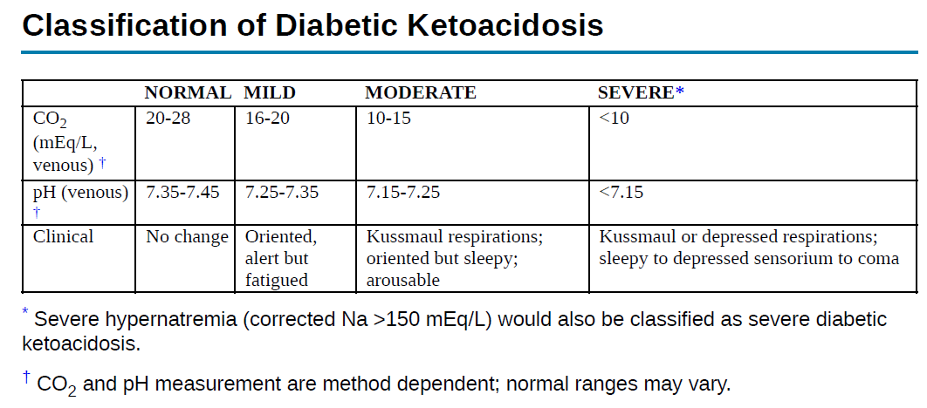

Slide 31
Investigations
✓ Blood glucose
✓ Blood (BOHB)
✓ Urine ketone
Electrolytes (including serum bicarbonate)
Blood urea nitrogen, creatinine
Serum osmolality
Venous pH, pCO2
Complete blood count (Hgb, Hct)
Culture (blood, urine, throat)

Slide 32
Differential Diagnosis
Alcoholic ketoacidosis
Uremia
Lactic acidosis
Sepsis
Hypoglycemia,
Hyperosmolar hyperglycemic state
Starvation ketoacidosis,
Renal failure
Ingestions such as salicylate, methanol, ethylene glycol, iron, or isoniazid.

Slide 33
Management of Diabetes Mellitus:
Can be approached in 3 Phases depending on the initial presentation; all of which have separate goals but in practice they merge in to a continuum.
Phase I :-DKA Management
Phase II:-Post acidotic or transition period for metabolic control.
Phase III:-The continuation phase with guidance of the Diabetic child and his or her family.

Slide 34
DKA Management

Slide 35
Where should the child with DKA be managed?
Experienced nursing and medical staff trained in pediatric DKA
management
Care policies and procedures based on clinical practice guidelines
Access to a laboratory appropriate for a standard of care
Home vs ER vs General ward vs PICU
  Severity of DKA
  Established vs new-onset DM
  Proficiency of caretakers
  Vomiting and feeding tolerance
  Institutional guidelines

Slide 36
Principles of Treatment
ABC of life
Careful replacement of fluid deficits.
Correction of acidosis & hyperglycemia
Correction of electrolytes imbalance.
Treatment of complications
Treatment of precipitating factor
Diabetic education
Monitoring and followup

Slide 37
The goals of therapy
Restore perfusion and correct dehydration
Stop Ketogenesis
Restore blood glucose to near normal
Correct electrolyte losses
Avoid complications of the Rx
Identify and treat any precipitating event

Slide 38
Fluid and electrolyte replacement
The objectives of fluid and electrolyte replacement therapy are to:
Restore circulating volume
Replace sodium and water deficits
Improve glomerular filtration and
Enhance clearance of glucose and ketones from the blood

Slide 39
Cont…
The general approach and principles of management are the same for all children with DKA, regardless of the severity.
Patients with DKA have a deficit in (ECF) volume that is typically about 7% of body weight
Shock with hemodynamic compromise is rare in pediatric DKA
Clinical estimates of the degree of dehydration are inaccurate .
Instead, patients should be rehydrated based upon a presumed fluid deficit and clinical response

Slide 40
Cont..
Recommendations based on PECARN FLUID Trial:
Assumed fluid deficits between 5%-10% of body weight
Replacement of deficits over 24 to 48 hours
Provision of maintenance fluids
Use of fluids with a sodium content between 0.45% and 0.9% NaCl
Notes:
Update
The PECARN trial showed that different fluid rates and sodium concentrations did not increase the risk of cerebral edema, so standard rehydration over 24–48 hours is appropriate.

Slide 41
Cont…
Resuscitation fluids: initial fluid resuscitation
Initial volume expansion of 10 to 20 mL/kg should be administered as an IV bolus, using isotonic saline or Ringer's lactate infused over 20 to 30 minutes .
If circulating volume is still compromised after the initial bolus is complete, additional IV bolus infusions of 10 to 20 mL/kg can be given.
10-20 ml/kg NS for iv volume depletion but not shock
20ml/kg for shock
Notes:
"The first treatment given is isotonic fluid."

Slide 42
Cont…
Deficit replacement
Over 24-48
NS
Change fluid to D5 containing when the plasma glucose falls to 250-300 mg/dl.
Subsequent fluid administration —
Once the child is hemodynamically stable, additional IV fluids should be administered, using IV fluids with 0.45 to 0.9% NaCl.
The rate of fluid administration is calculated to replace the remaining fluid deficit over 24 to 48 hours.
Notes:
Deficit Replacement
What to say:
"After the child becomes hemodynamically stable, the remaining fluid deficit is replaced slowly.

Slide 43
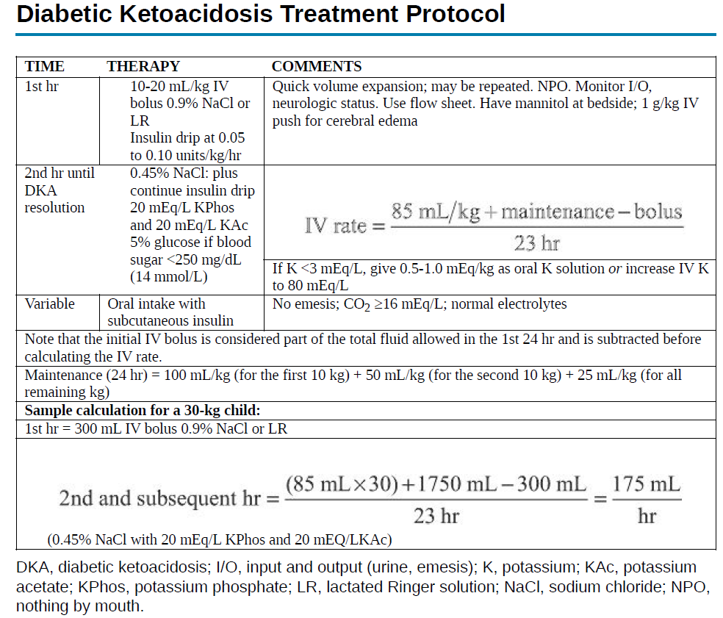
Notes:
20 mEq/L KPhos
20 mEq/L KAc

Slide 44
Potassium replacement
Children with DKA have total body potassium deficits on the order of 3 to 6 mmol/kg
The major loss of potassium is from the intracellular pool transcellular shifts caused by
hypertonicity
urinary potassium excretion
vomiting

Slide 45
Cont…
Potassium replacement is required regardless of the serum potassium concentration , except if renal failure is present.
If patient is hypokalemic, start potassium replacement at the time of initial volume expansion and before starting insulin therapy .
using a separate iv infusion with a potassium concentration of 40 mmol/L.

Slide 46
Cont…
Otherwise, start replacing potassium after initial volume expansion and concurrent with starting insulin therapy
If patient is hyperkalemic, it is recommended that Potassium is only added to IV fluids after the patient;
Has passed urine
gives a history of having recently passed urine
after the Potassium has fallen to within the upper limit of the normal range

Slide 47
Cont…
Potassium assessment
Total body potassium is always depleted in DKA
If serum K⁺ result is delayed → perform baseline ECG
  Tall peaked T waves → hyperkalemia
  Flat T waves / U waves → hypokalemia

Slide 48
Phosphate
Phosphate depletion occurs in DKA due to urinary loss from osmotic diuresis,
reduced renal tubular reabsorption of phosphate and a shift of intracellular phosphate to the extracellular compartment as a result of metabolic acidosis

Slide 49
Cont…
During treatment,50%–60% of children develop hypophosphatemia.
Severe hypophosphatemia (<1 mg/dl [0.32 mmol/L]) with or without associated symptoms should be treated promptly

Slide 50
Sodium
Promoting a rise in serum sodium concentrations during DKA treatment is no longer considered necessary
Corrected Na = measured Na + 1.6([plasma glucose - 5.6]/5.6) mmol/L or measured Na + 1.6([plasma glucose – 100]/100) mg/dL
As the plasma glucose concentration falls, measured and corrected sodium should rise 1.6 mmol/L for each100 mg/dL.

Slide 51
Bicarbonate
Bicarbonate administration is not recommended except for treatment of life-threatening
hyperkalemia or for severe acidosis (venous pH <6.9) with evidence of compromised cardiac contractility

Slide 52
Insulin
Start insulin infusion 1 hr after initiation of IV fluid treatment
Dose: 0.05-0.1 U/kg/hour of regular insulin
lower dosage (0.05 U/kg/hour) can be considered for children with pH>7.15
(e.g. dilute 50 units regular [soluble] insulin in 50 mL normal saline, 1 unit = 1 mL)
Route of administration: Intravenous (IV)
Infusion tubing should be flushed with 20 ml insulin solution before administration.

Slide 53
The dose of insulin should usually remain at 0.05-0.1 unit/kg/hour at least until resolution of DKA
  pH >7.30,
  serum bicarbonate >18 mmol/L,
  BOHB <1 mmol/L,
  or closure of the anion gap
If the insulin effect is adequate, serum BOHB should decrease by approximately 0.5 mmol/L per hour

Slide 54
If iv infusion is not possible
hourly or 2-hourly SC rapid acting insulin analog (insulin lispro or insulin aspart) is used
Dose SC: 0.15 units/kg every 2 hours
The dose can be reduced to 0.1 unit/kg every 2 hours if BG continues to decrease by >5 mmol/L (90mg/dL) even after adding dextrose

Slide 55
Monitoring
Hourly monitoring
  Vital sign
  Neurologic assessment
  Insulin administration
  Fluid balance
  Capillary blood glucose
Every 2-4 hr
  Serum electrolytes, calcium, magnesium, BUN, phosphate, and blood gas
  Blood BOHB concentrations/Urine ketone

Slide 56
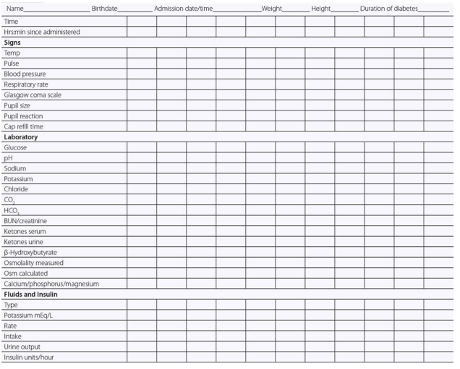
DKA/HHS STATE FLOW SHEET

Slide 57
Resolution of DKA
Serum anion gap reduced to normal (12±2 mEq/L) or serum BOHB ≤1 mmol/L (10.4 mg/dL)
Venous pH >7.3 or serum bicarbonate >15 mEq/L
Blood glucose <200 mg/dL (11.1 mmol/L)
Patient is tolerating oral intake

Slide 58
Transition
Oral fluids should be introduced only when substantial clinical improvement has occurred (mild acidosis/ketosis may still be present)
When oral fluid is tolerated, IV fluid should be reduced.
In patients with insulin infusion to prevent rebound hyperglycemia the first SC injection should be given 1-2 hours (with Regular insulin) before stopping the insulin infusion.
In our case you can adjust the time for the initiation of standing dose, until that give ½ of the six hourly regular insulin dose.

Slide 59
Complications during DKA management
Hypoglycemia
Cerebral Edema
Hypokalemia
Hypophosphatemia
Acute Kidney Injury
Acute Respiratory Distress Syndrome
Hyperchloremic Acidosis

Slide 60
1.Hypoglycemia
Glucose value <3.9 mmol/L (70 mg/dl) is used as the clinical alert or threshold value for initiating treatment for hypoglycemia
Determine underlying cause.
Monitor blood glucose every 15 minutes until blood glucose is >100mg/dl.

Slide 61
An international consensus panel
✓ Clinical hypoglycemia alert – Blood glucose <70 mg/dL ( this is commonly used as a threshold for recognizing and initiating treatment for hypoglycemia.
✓ Clinically important or serious hypoglycemia – Blood glucose <54 mg/dL defective glucose counterregulation, impaired hypoglycemia awareness, and, sometimes, cognitive dysfunction.
✓ Severe hypoglycemia – An event associated with severe cognitive impairment (including coma and seizures), requiring assistance of another person to correct, including administration of carbohydrates or glucagon or intravenous (IV) dextrose.

Slide 62
Clinical classification of severity
Mild : tremor, palpitations, diaphoresis, headaches, and behavior changes.
older children can treat themselves with oral intake.
Moderate : neurologic symptoms consist of sufficient neurologic impairment
a second person has to administer oral therapy.
Severe : unresponsiveness, seizures, or coma, requires SC administration of glucagon or IV dextrose

Slide 63
cont…
Asymptomatic hypoglycemia:
Treated orally with a concentrated and rapidly absorbed simple carbohydrate food source
(10 to 15 g glucose).
Wait 10–15 minutes
If no response, repeat above.
As symptoms improve, the next meal or oral complex carbohydrate should be ingested

Slide 64
Cont….
Symptomatic hypoglycemia:
Dextrose IV, 2–5 mL/kg of 10% glucose (200 to 500mg/kg). In glucose 10% solution
IV fluid with concentration of > 10% glucose (glucose concentration = 12%) can be given if no response.
Monitor blood glucose every 15 minutes until stable, then repeat 1–2 hourly.

Slide 65
Prevention
Eating meals and snacks on a regular schedule after medications
Checking blood glucose levels as directed during exercise
Sticking to a suggested exercise plan
Carrying juice, candy, or glucose tablets at all times, in the event that one develops symptoms of hypoglycemia

Slide 66
2.Cerebral edema
This complication has a high mortality rate.
Patients who experience cerebral edema with DKA, as many as one-fourth die and another one-fourth have permanent neurologic sequelae.
Poor outcome has been associated with;
  Greater neurologic depression at the time of diagnosis of their cerebral edema,
  Elevated initial serum BUN concentration, and
  Intubation with hyperventilation to a PCO2 less than 22 mm Hg (demanding caution in hyperventilating affected patients).

Slide 67
Mechanism of cerebral edema
The cause of DKA-related cerebral injury is a topic of ongoing Investigation.
Rapid fluid administration resulting in changes in serum osmolality was initially thought to be the cause, however, more recent evidence suggests that cerebral hypoperfusion and the hyperinflammatory state caused by DKA play central roles

Slide 68
Risk factor
Pre treatment
while on treatment
Younger age
Sick appearance
New-onset
Longer duration of symptoms
More severe evidence of dehydration
Greater acidosis (lower pCO2, pH)
Too-rapid fall glucose
Failure of sodium to rise
Too-rapid fall osmolality
Use of bicarbonate
Early insulin treatment
Use of fluids:≥ 50 mL/kg in the first 4 hours

Slide 69
Signs and symptoms
  sudden deterioration in mental status
  severe headache
  sudden drop in heart rate not attributed to rehydration
  hypertension, cranial nerve dysfunction, and incontinence.
  Cushing's triad( late sign)
  Decreased O2 saturation

Slide 70
Diagnosis
Diagnostic criteria
  Abnormal motor or verbal response to pain
  Decorticate or decerebrate posture
  Cranial nerve palsy (especially III, IV, and VI)
  Abnormal neurogenic respiratory pattern (e.g., grunting, tachypnea, apneusis
  Cheyne-Stokes respiration)
Minor criteria
  Vomiting
  Headache
  Lethargy or not easily arousable
  Diastolic blood pressure > 90 mmHg
  Age <5 years
Major criteria
  Altered mentation, confusion, fluctuating level of consciousness
  Sustained heart rate deceleration not attributable to improved intravascular volume or
  sleep state
  Age-inappropriate incontinence
Treat
  One Diagnostic criteria
  two major criteria,
  one major and two minor criteria

Slide 71
Management
  Reduction in the rate of fluid administration
  Elevation of the head of the bed
  Administration of intravenous mannitol in a dosage of 0.25 to 1.0 g/kg over 10-15 minutes, repeated as necessary after 30min.
  Hypertonic saline (3%), suggested dose 2.5 to 5 mL/kg over 10 to
  15 minutes
    may be used as an alternative to mannitol, or
    in addition to mannitol if there has been no response to mannitol within 15 to 30 minutes.
  Hypertonic saline (3%) 2.5 mL/kg is equimolar to mannitol 0.5 g/kg

Slide 72
Effects of manitol
  lowering hematocrit and blood viscosity, which improves cerebral blood flow (CBF) and oxygenation
  Improvement in red cell deformability
  vasoconstriction in areas of the brain with intact autoregulation or improved autoregulation from the effects of the mannitol on CBF and oxygenation; and
  Direct osmotic effects with reduction in extracellular free water.
  Intubation - for those who have progressed to respiratory compromise

Slide 73
3.Akute Kidney Injury
Can occur upto 43 to 64 percent
Many of these children have stage 2 or 3 AKI, suggesting intrinsic tubular injury beyond prerenal dysfunction
Renal failure can also occur but is rare
AKI generally resolves after recovery from DKA

Slide 74
4.Acute Respiratory Distress Syndrome
Non-cardiogenic pulmonary edema results from reduced colloidal oncotic pressure in pulmonary capillaries due to crystalloid replacements in DKA.
Presence of hypoxemia with elevated pulmonary alveolar-arterial gradient, warrant suspicion
It can be avoided by judicious fluid replacement.

Slide 75
5.Hyperchloremic Acidosis
The use of large amounts of chloride-rich fluids may be associated with the rapid development of hyperchloremia
It is defined as [Cl-:Na+] >0.79 and hyperchloremic metabolic acidosis.
Hyperchloremic acidosis resolves spontaneously

Slide 76
Phase III :continuing or maintenance phase.
Includes the insulin regimen after the patient has maintained the target RBS for the transition phase in the past 24 hours.
i) In Newly diagnosed DM: 2/3 of the calculated total subcutaneous insulin in the past 24 hours will be the representative daily dose in the maintenance phase.
ii) For known DM patients : the calculated total subcutaneous insulin in the past 24 hours will be the representative daily dose in the maintenance phase

Slide 77
Cont…
Out of the total daily insulin requirement, 2/3 will be given in the morning & the remaining 1/3 in the evening.
And 2/3 will be intermediate acting & 1/3 fast acting insulin.
The ideal target RBS during this regimen is 80mg/dl for fasting & 140mg/dl after meal; but in practice a range of 60 – 220mg/dl is acceptable based on the age of the patient.
RBS measurements that are constantly out of this range without identifiable cause, are indications for adjusting insulin doses;i.e.by increasing or decreasing the next insulin dose by 10 – 15%.

Slide 78
Reference
ISPAD 2022
Uptodate 2026
Nelson 21st edition

